Slide 1
DANGERS of Marijuana
By: Ashley Cienciera, Ashley Hendrie, Lindsey Christian

Slide 2
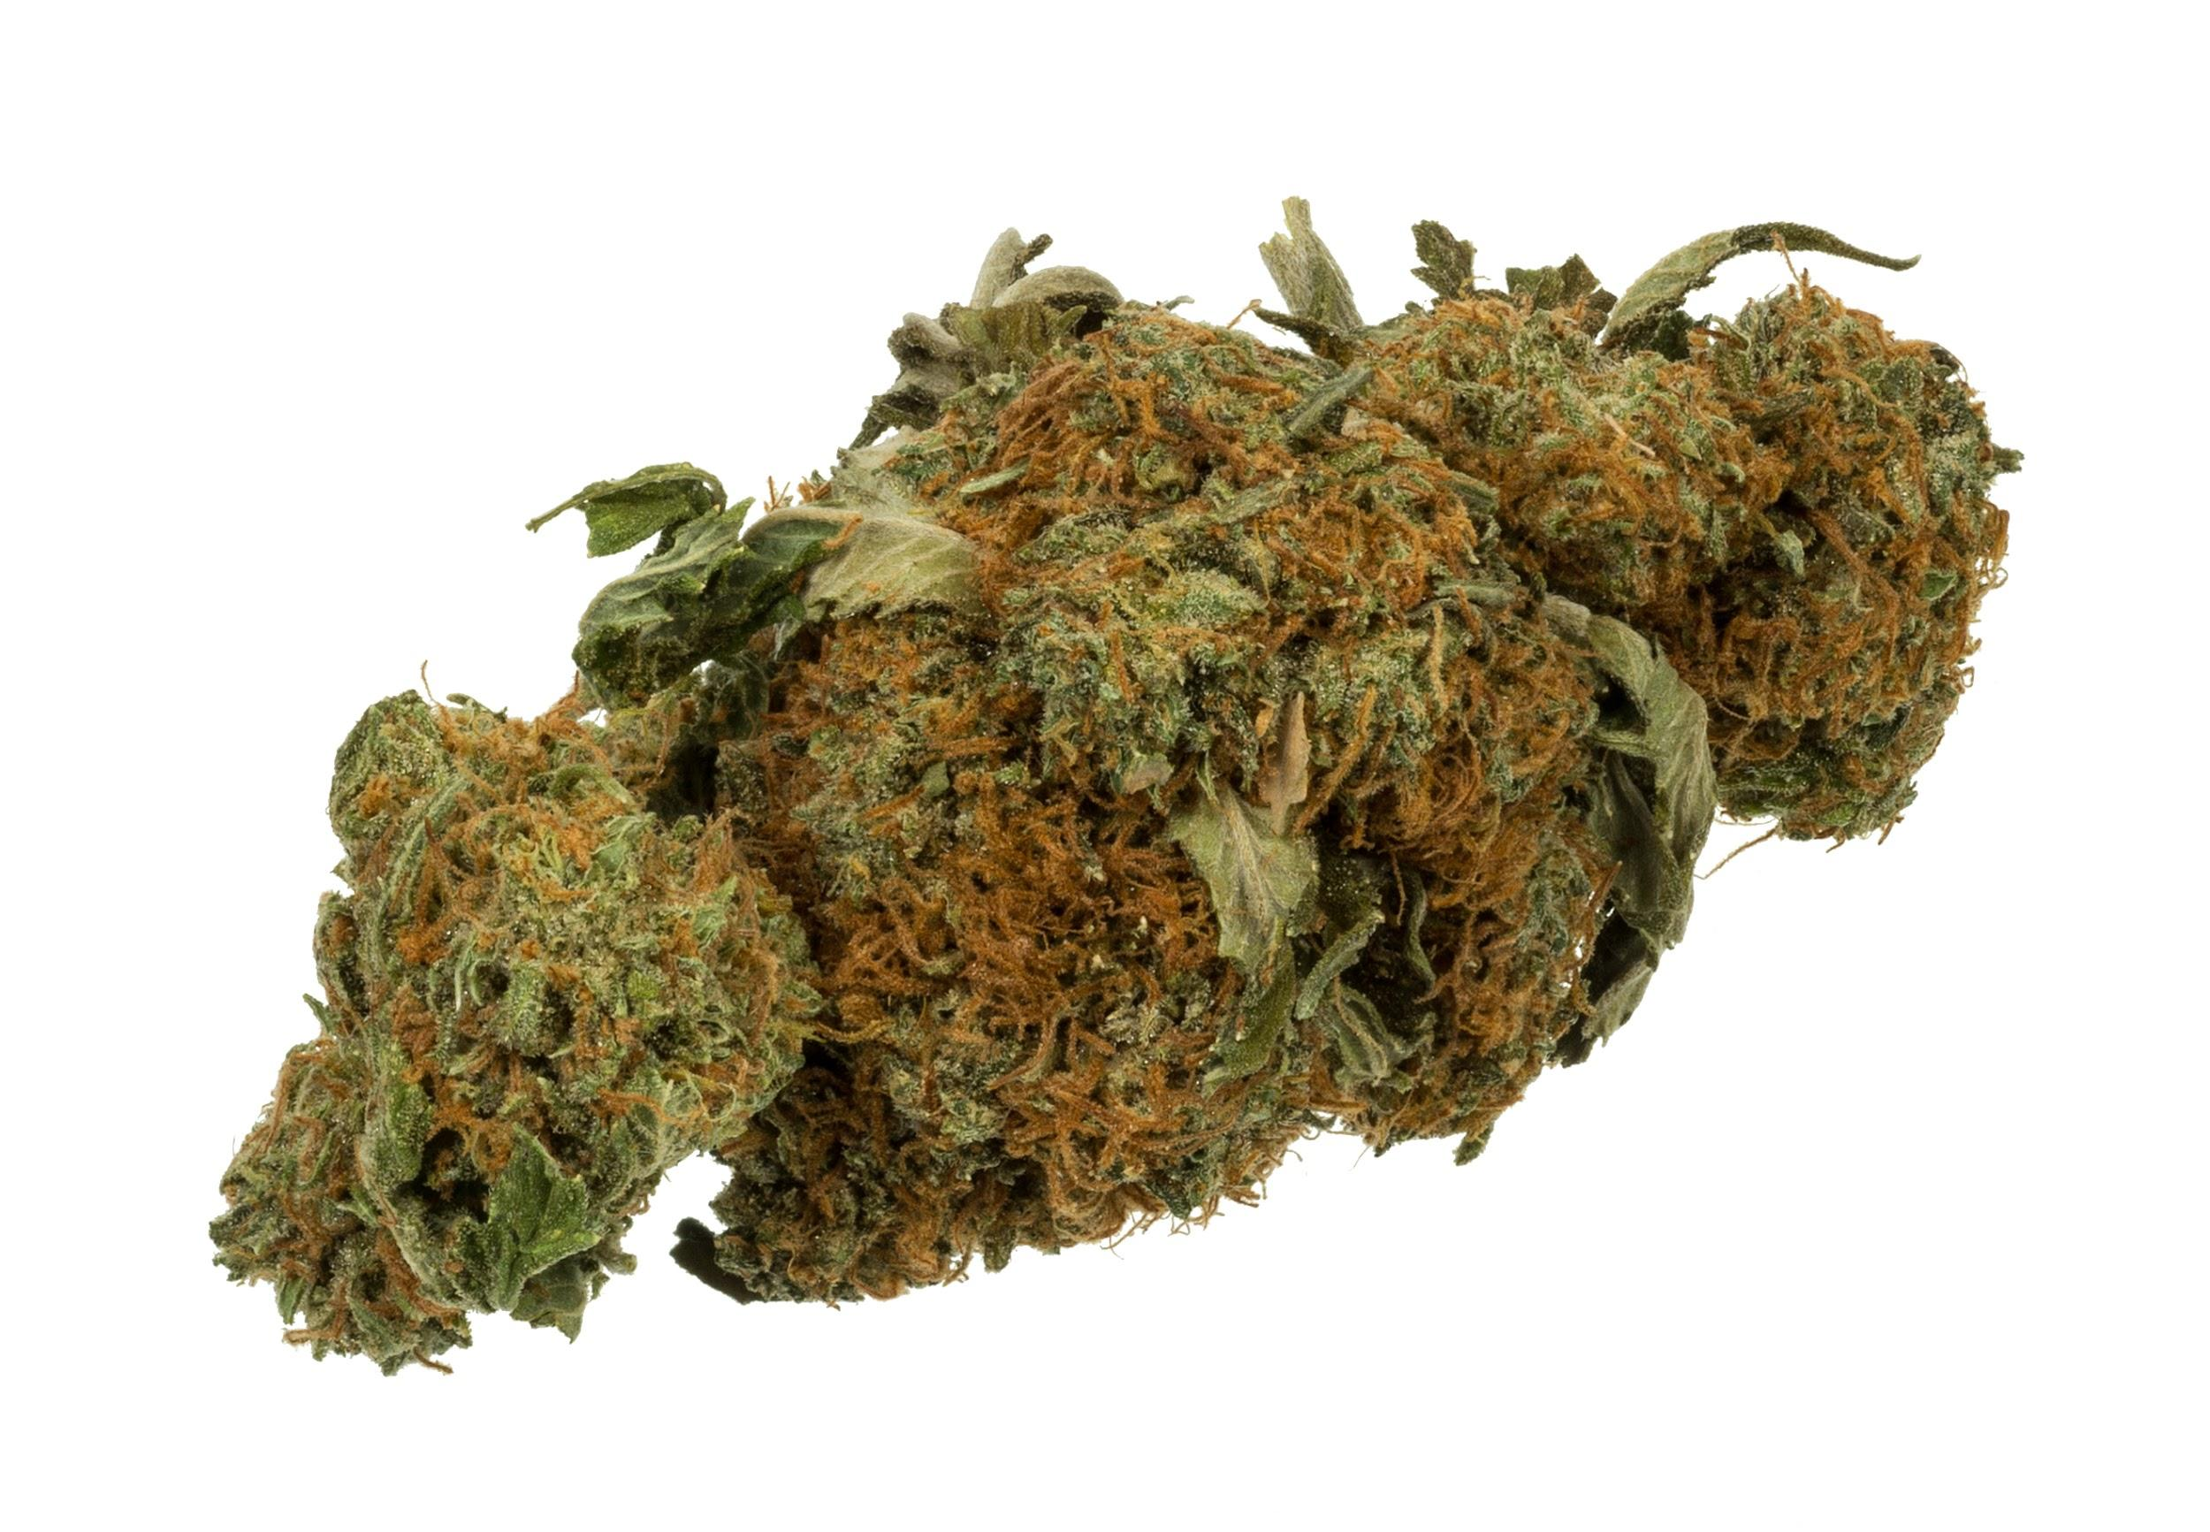
What is Marijuana?
Marijuana is dried leaves, flowers, stems, and seeds that is composed of cannabis sativa which is hemp.
Marijuana is illegal in most states. Twenty-three states legalized it in a medical form, such as Michigan.
THC such as Delta-9-tetrahydrocannabinol is illegal.

Slide 3
Reason For its Use
Peer Pressure- because friends or siblings use it.
Family Influence- because they see older people in family using it.
Belief of escaping from problems at home, school, or with friends.

Slide 4
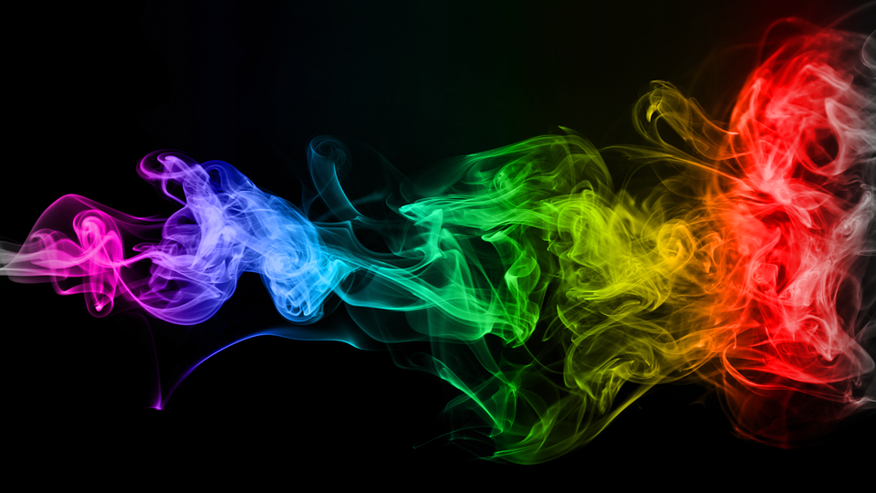
How to say NO
Say what the problem is (it’s illegal)
Say what the consequences are
Suggest something else to do instead
Decide in advance what you intend to do
Think of some good ways to handle the situation if it occurs

Slide 5
The Dangers/Effects of Marijuana
Marijuana smoke, like tobacco smoke, contains many harmful chemicals which can damage or irritate your lungs.
The irritants can cause lung inflammation which can lead to frequent coughing or bronchitis (as well as a lung infection).

Slide 6
The Dangers/Effects of Marijuana
Effects of smoking marijuana includes rapid heart beat, disorientation, lack of physical coordination, often followed by depression and anxiety.
THC binds to proteins in the brain that are located in areas regulating mood, sensation, memory, feelings, and etc.

Slide 7
Effects of Marijuana
Increased heart rate
dryness of the mouth
increased depression and anxiety
impaired short term memory
impaired motor coordination

Slide 8
Effects of Marijuana
paranoia and psychosis
Altered brain development
Less life satisfaction and achievement

Slide 9
Long Term Effects
Bronchitis COPD
emphysema suppresses immune system
bronchial asthma physical dependency

Slide 10
Summay
Being an adolescent is a risk factor for trying illicit drugs (especially marijuana) which further leads to habitual usage.

